Slide 1
Telecommunication Customer Churn
P-282
Group - 3

Slide 2
Agenda
1. Understanding the Dataset
2. EDA
3. Feature selection
4. Model Building
5. Model Deployment
6. Demonstration of Deployment

Slide 3
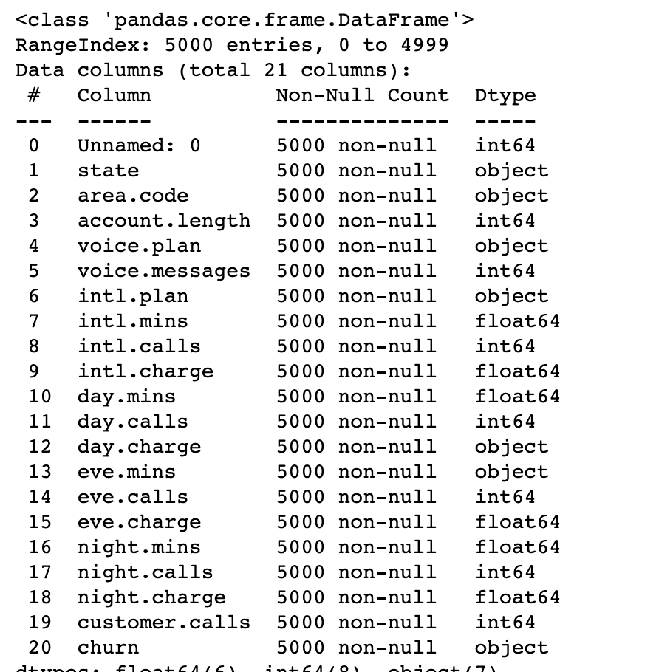
Understanding Data
Data Shape - 5000,21
Except day.charge and eve.mins all dtype are fine.
No empty rows for any column
Deleting irrelevent columns

Slide 4
EDA and Data Visualisation

Slide 5
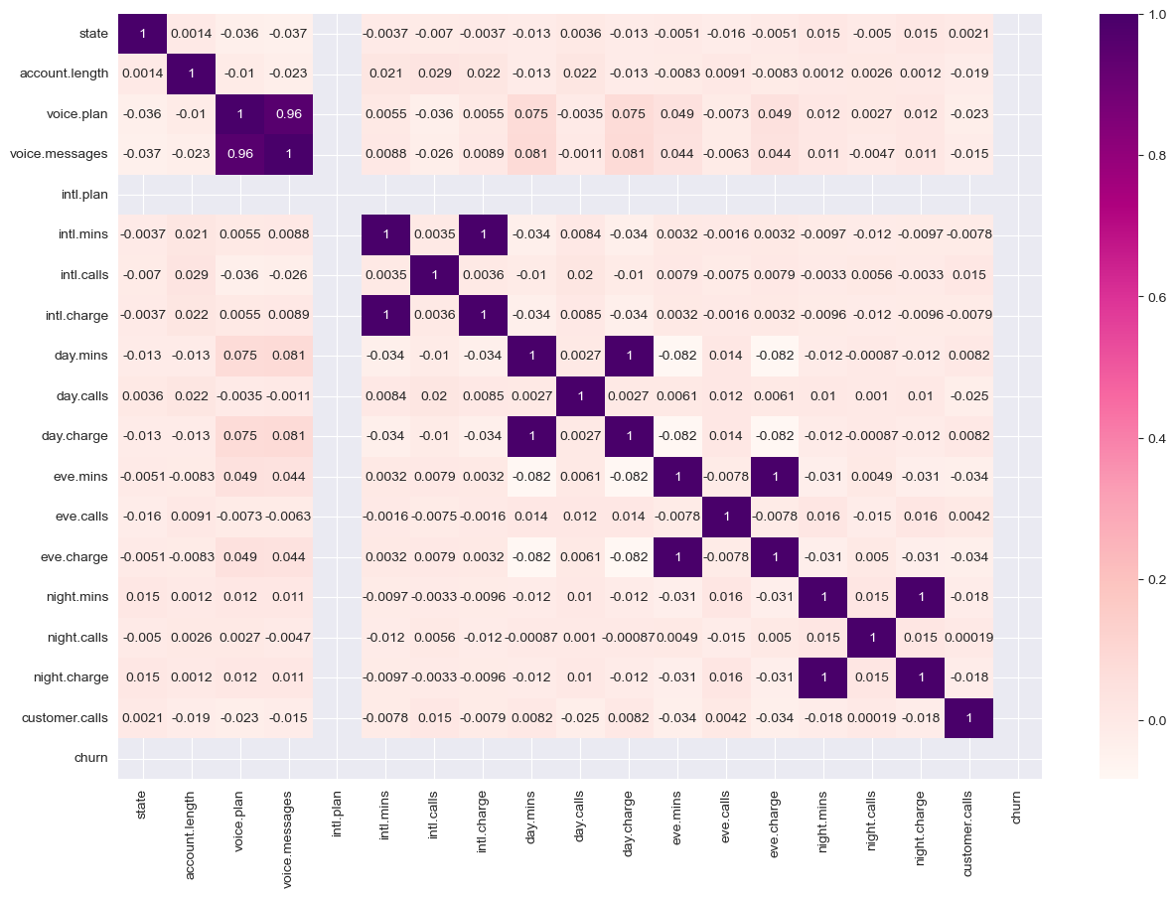
Correlation of Feature

Slide 6
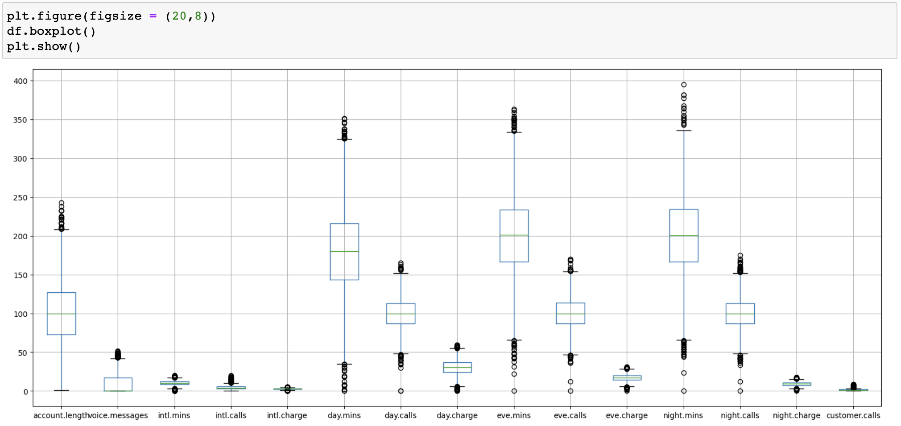
Outliers?

Slide 7
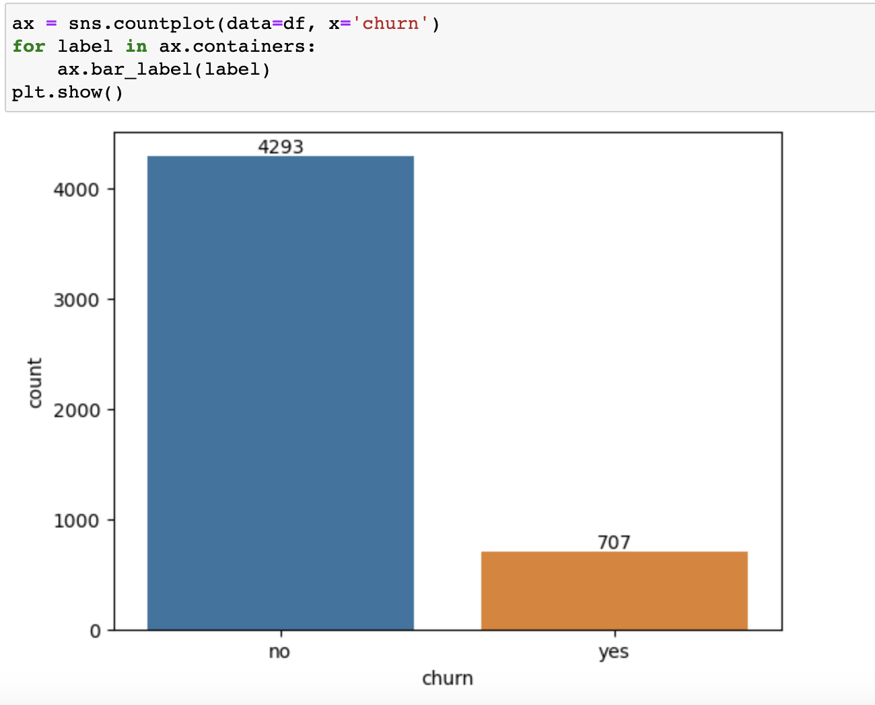
Is Data balance?

Slide 8
Feature Engineering

Slide 9
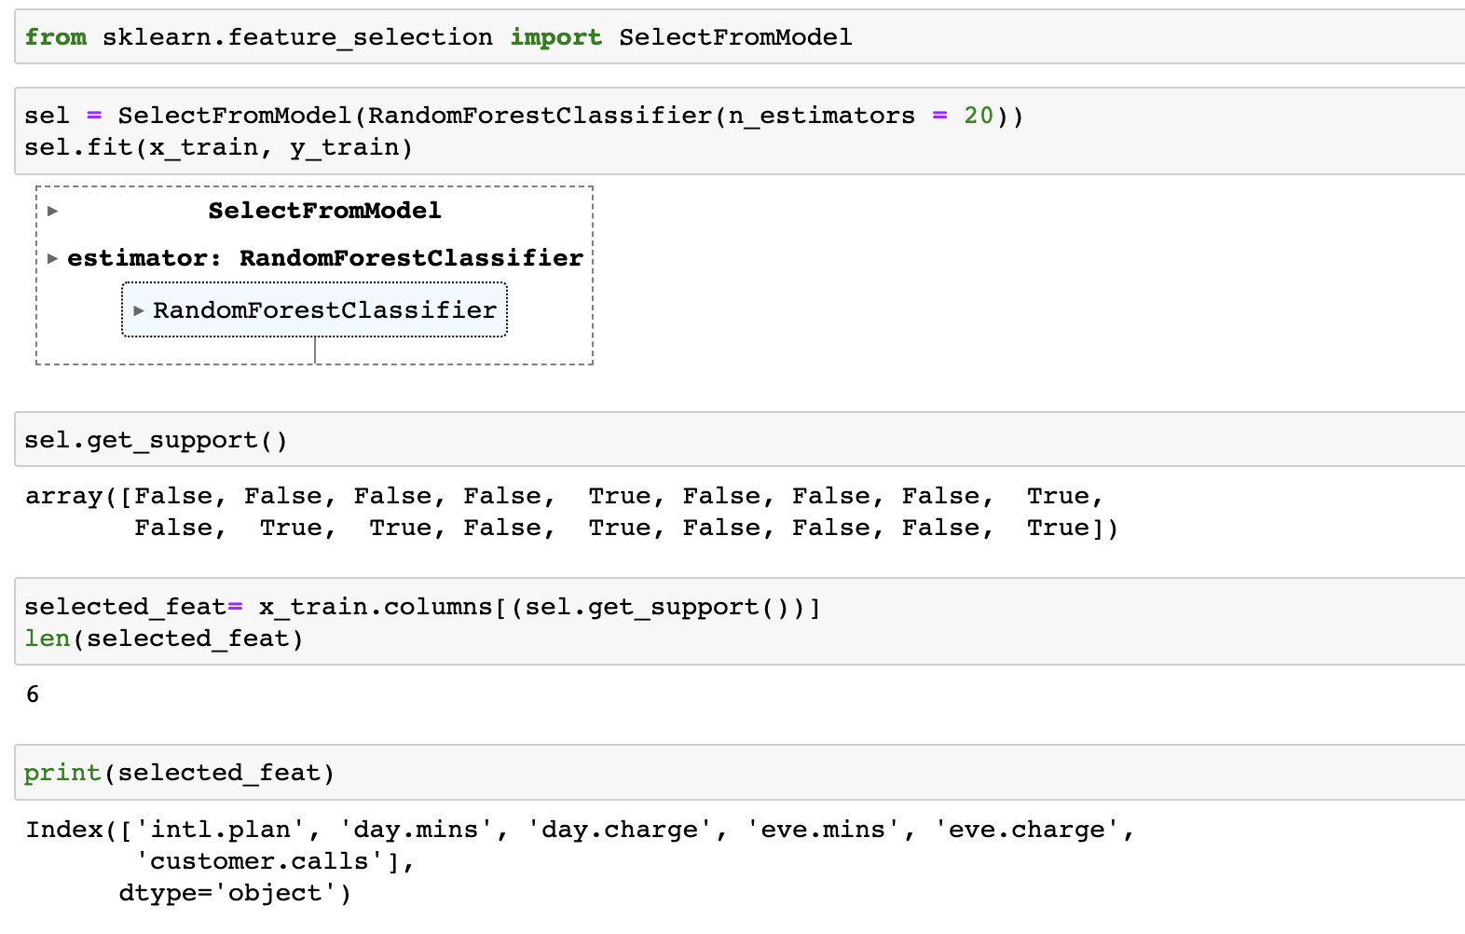
Tree Based Feature Selection

Slide 10
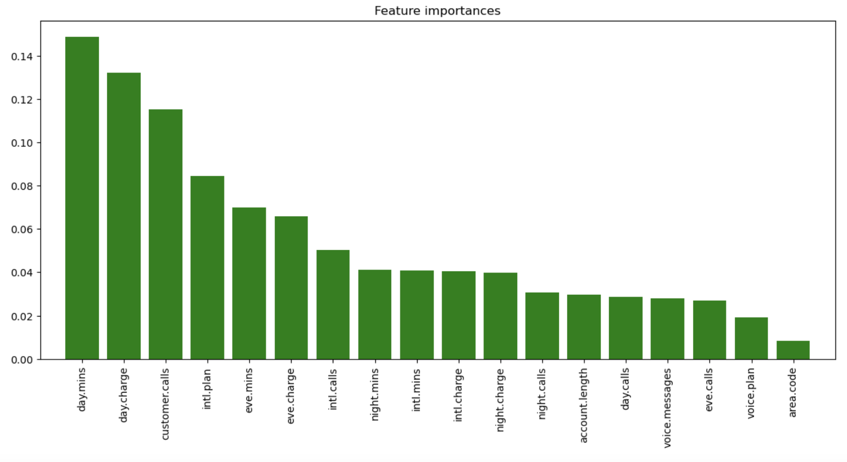
Output of Feature Selection

Slide 11
Model Building

Slide 12
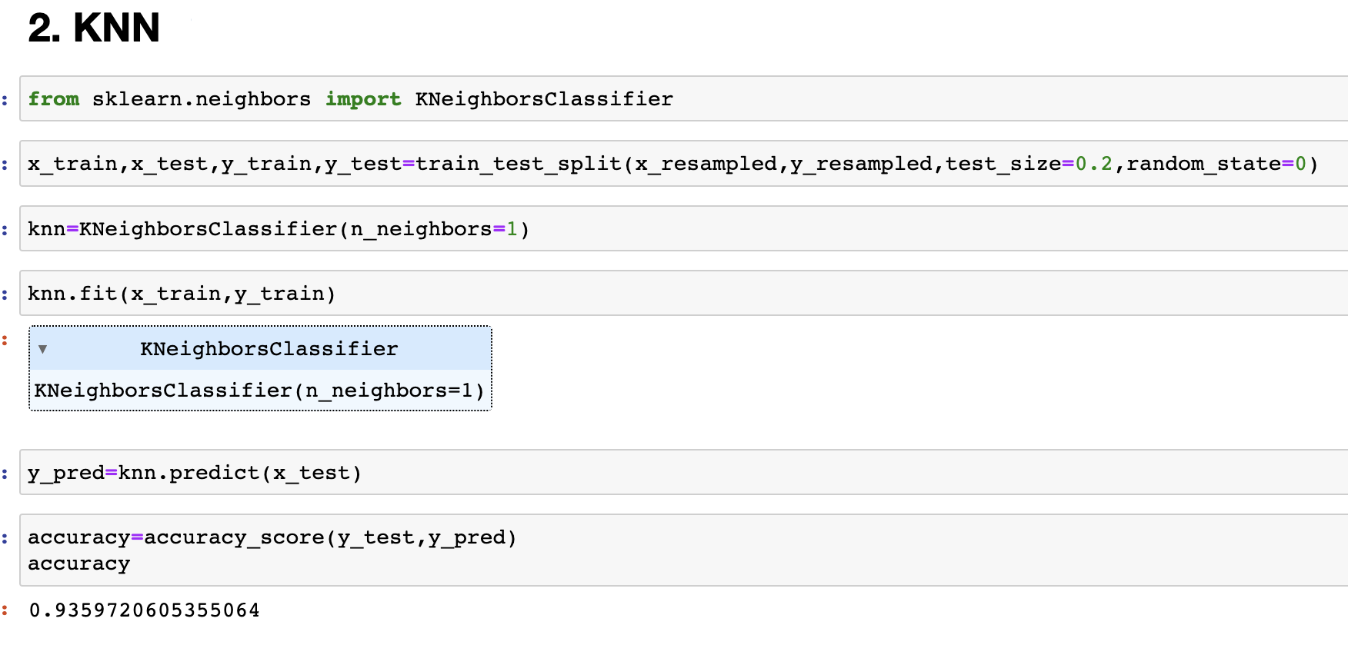
K-Nearest Neighbour

Slide 13
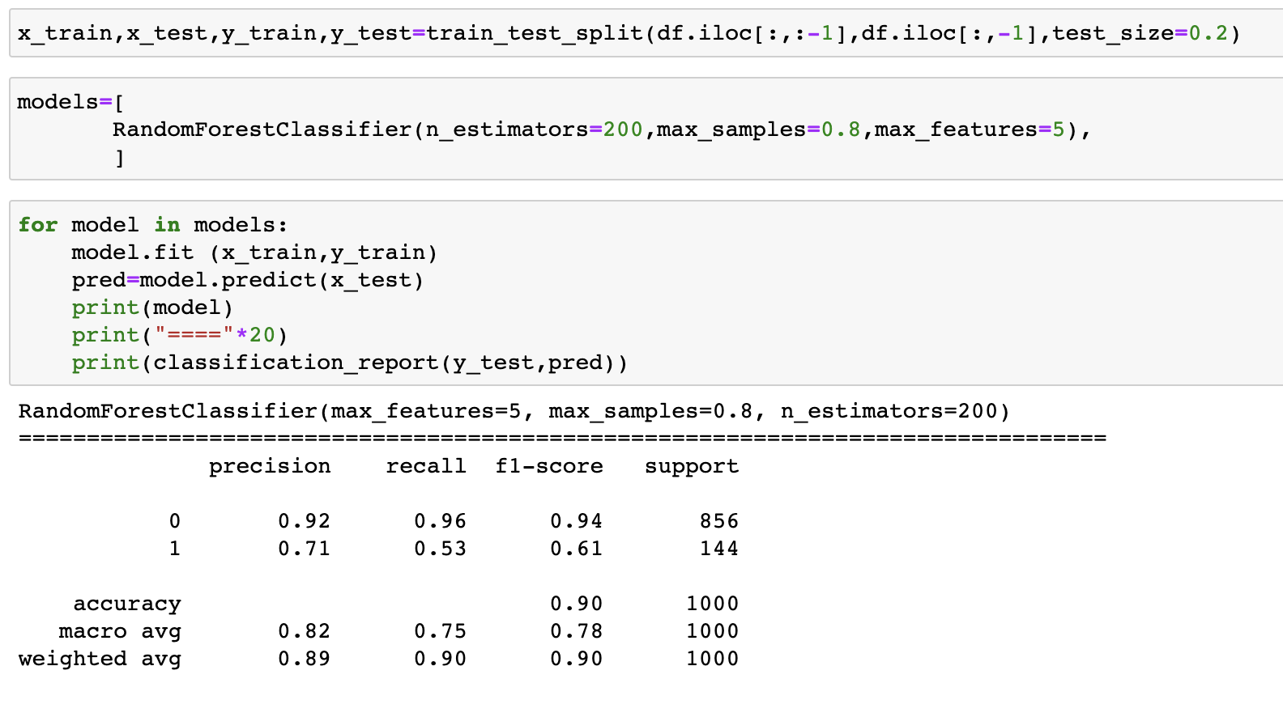
Random Forest

Slide 14
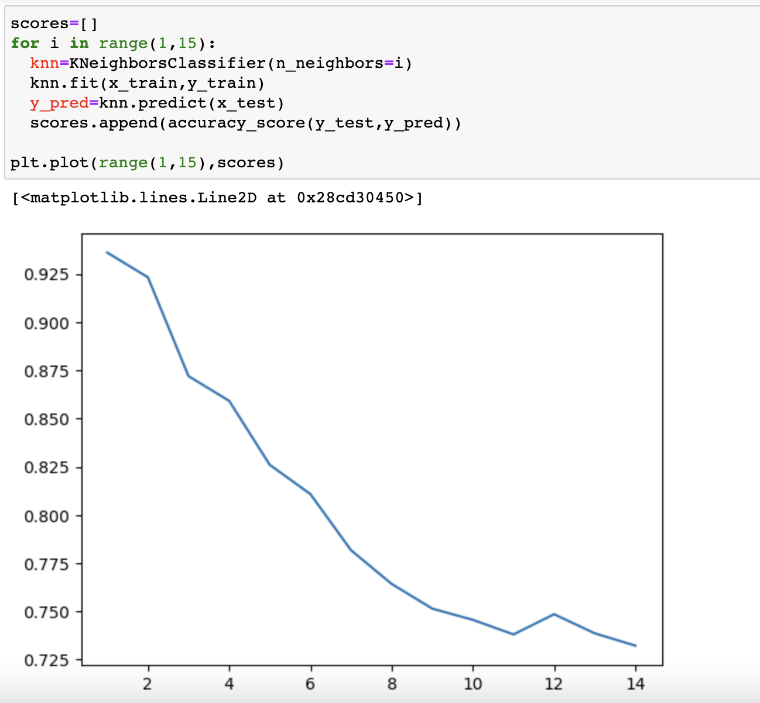
Why Number of cluster(n) is 1?

Slide 15
Model Deployment

Slide 16
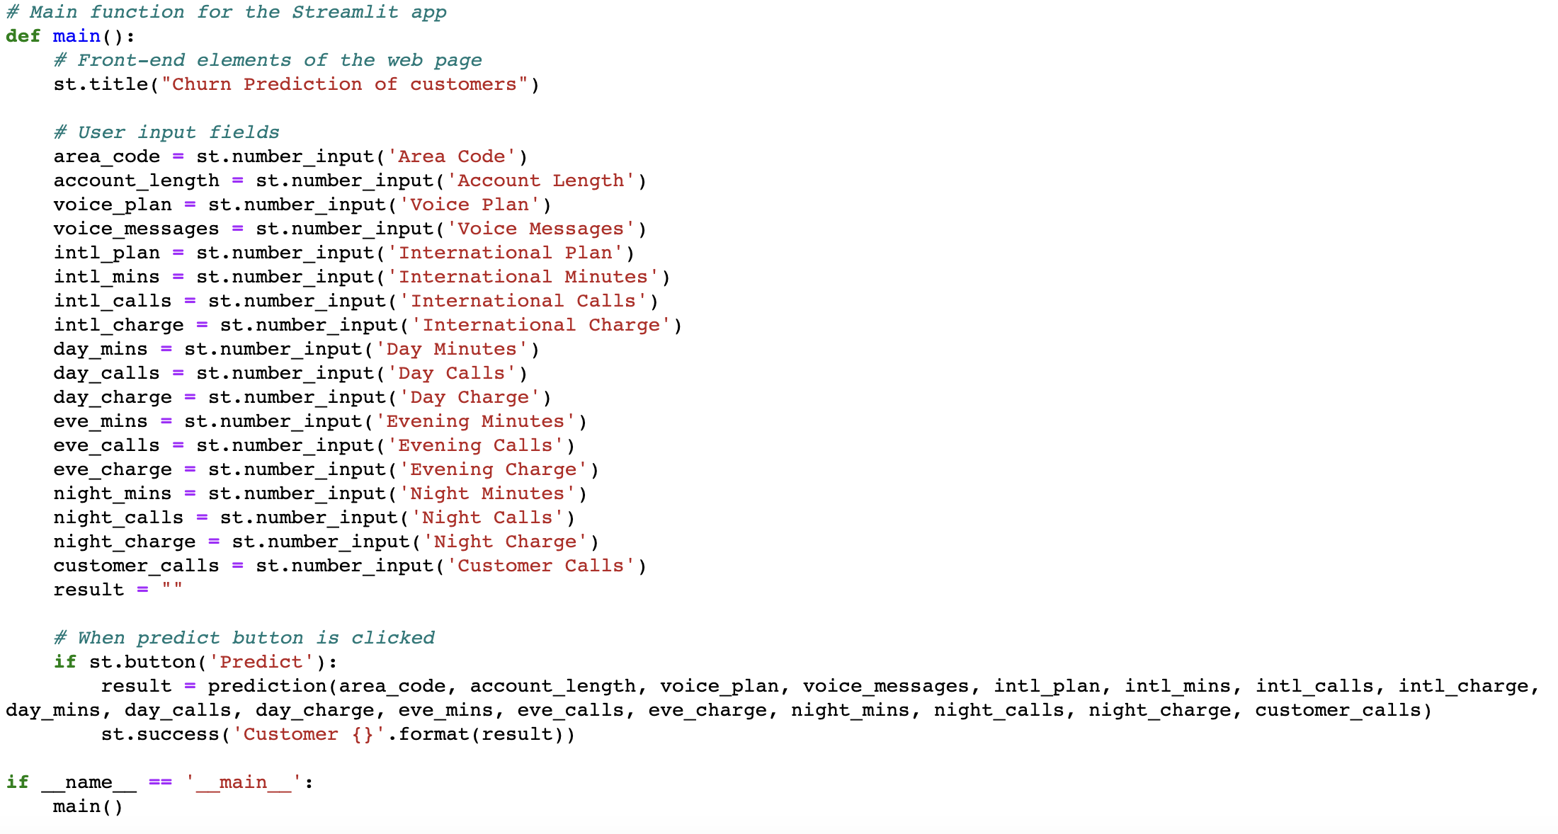
Details of Pickle File

Slide 17
Demonstration of Deployment…

